Slide 1

Achievers
BlueCollarConnect
Team :
Gowtham Reddy Mallu (Team Leader)
Sneha Reddy Dendi

Slide 2
Table of contents
01
02
03
System & System Development Platform
Problem Statement and solution
Similar Systems
04
05
06
Similarities
New Features & User Acquisition
Responsibilities

Slide 3


System & System Development Platform
Software
FrontEnd : HTML5, BootStrap, CSS
HTML5
Pro’s:- HTML5 increases the structure of web pages with more semantic elements.
Supports audio & video embedding without external plugins.
Con’s:-Some older browsers may not fully support HTML5, leading to compatibility issues for users who
haven't updated their browsers.
BootStrap
Pro’s:-Bootstrap makes it easier to create mobile-friendly and responsive websites, guaranteeing consistent and best-in-class
user experiences on a range of devices.
Con’s:- Bootstrap is highly customizable, making extensive modifications to its default styles may require additional
effort and could be challenging in some cases..
CSS
Pro’s :-CSS makes it possible to style multiple pages consistently, giving a website a unified and polished look.
CSS supports responsive design, enhancing user experience.
Con’s:- Organizing and managing CSS code can become difficult as web projects get more complex, which could result in maintenance problems.

Slide 4


System & System Development Platform
Software
BackEnd : Django, Python
Django
Pro’s:- Provides High-Level Abstraction. Django simplifies web development with a high-level framework and
provides built in features reducing integration needs.
Con’s:-Django's high-level abstraction might require time for beginners to fully understand.
Python
Pro’s:- The emphasis on readability in Python's syntax lowers the cost of program development and maintenance.
Python's simplicity makes it easy for beginners to learn and use.
Provides both an extensive ecosystem of third-party libraries and a robust standard library.
Con’s:-The Global Interpreter Lock may present a challenge in multi-threaded applications.

Slide 5

System & System Development Platform
Software :
Data Base : SQL
SQL
Pro’s:- Easy To Use
SQL is a declarative language, allowing users to focus on describing the desired outcome rather than specifying the step-by-step process. It is therefore more approachable and simpler to learn.
Con’s:- Performance issues with SQL databases can arise in certain situations, particularly when dealing with complex queries or substantial datasets. To solve these problems, proper indexing and query optimization are crucial.

Slide 6



System & System Development Platform
Other Software’s:- Stripe(Payments), MailChimp(Sending mails), Heroku(Hosting)
Stripe
Pro’s:- Developers can easily integrate payment functionality into websites and applications with Stripe's user-friendly and well-documented API.
Con’s:- Businesses may discover that, despite being standard in the sector, Stripe's transaction fees are more expensive than those of certain other payment processors, particularly when it comes to microtransactions.
MailChimp
Pro’s:- Create and send email campaigns with ease—even for users with little technical experience.
Con’s:- As subscriber lists expand, Mailchimp's pricing model may become less economical, potentially increasing costs for larger enterprises.
Heroku
Pro’s:- Heroku makes deployment easier, freeing developers to concentrate on writing code instead of managing infrastructure. Provisioning, configuration, and scaling are managed by the platform.
Con’s:- Heroku's storage can be limited, particularly for large-scale applications that require a lot of data storage.
Stri

Slide 7


Problem Statement
India, with a vast population of 1.4 billion, experiences a significant migration of skilled workers from rural to urban areas seeking better opportunities.
Many skilled workers, including carpenters, electricians, beauticians, barbers, cleaners, and mechanics, hail from rural areas, face difficulties to get jobs in urban areas..
In urban areas, people encounter difficulties finding and connecting with skilled workers, leading to a significant gap between the demand for services and the availability of skilled professionals.

Slide 8
Solution - Our Website
Our platform aims to bridge the gap by providing a centralized space for skilled workers from rural areas to connect with urban residents seeking their services, fostering a seamless exchange of skills.
We offer a comprehensive support system on the platform, providing guidance for rural workers navigating the challenges of migration to urban areas, including resources, mentorship, and assistance in finding opportunities.
Utilizing advanced algorithms, our website ensures efficient matchmaking between users in urban areas and skilled workers, making it easy for individuals to find the right service providers and vice versa.

Slide 9
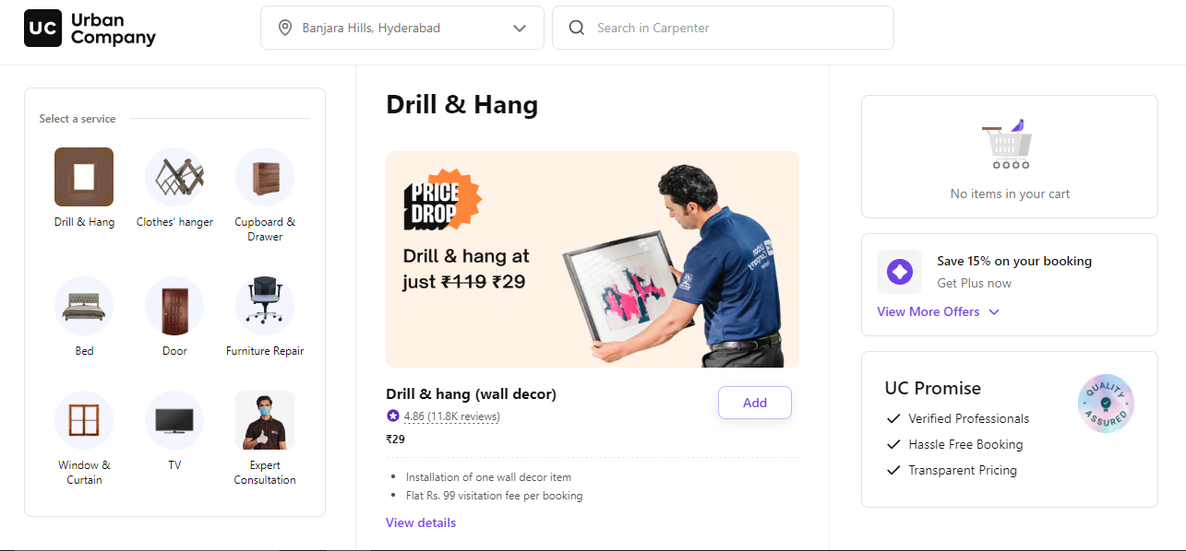
Similar Systems
Urban Clap
Introduction
Urban Clap, now known as Urban Company, is one of India's top on-demand home service platforms, having debuted in 2014.
For a variety of services like fitness, beauty, wellness, repairs, cleaning, and pest control, it links users with verified professionals.
With operations in more than 80 Indian cities, the company is very well-known.

Slide 10

Pros Of Urban Clap
Convenience: Using the app to book services is quick and simple; long searches or phone calls are no longer necessary.
Broad range: Urban Company provides a huge variety of services, addressing different needs all in one place.
Verified professionals: They make sure that service providers are top-notch by checking and verifying all their qualifications.

Slide 11
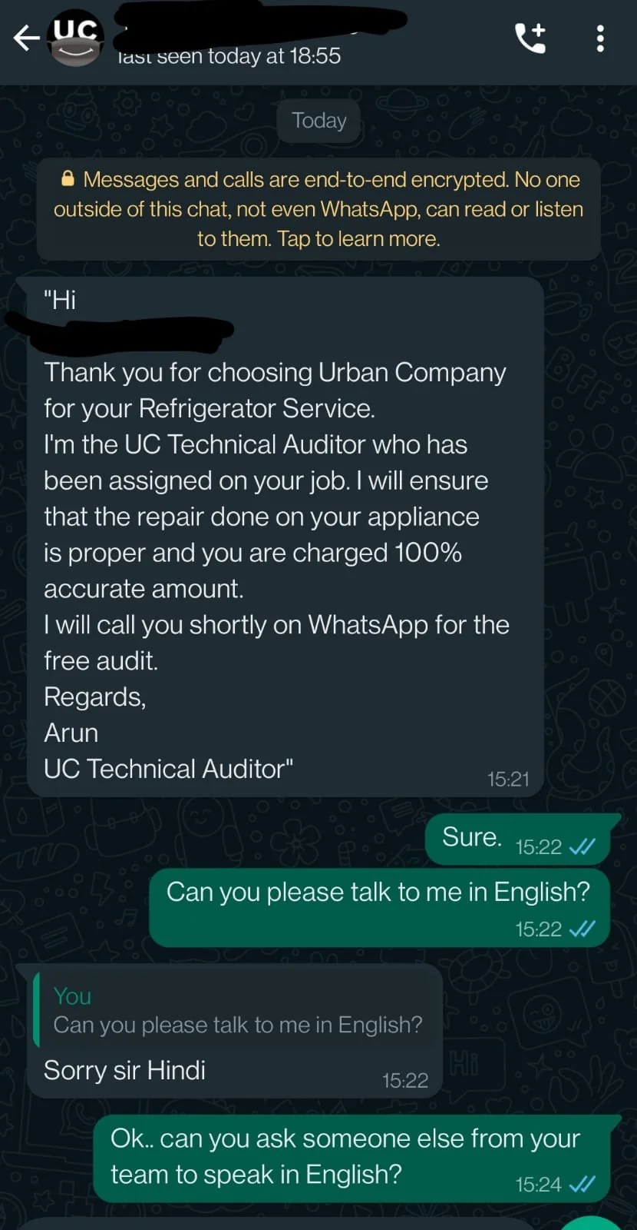
Cons of Urban Clap
Registration Page Redirects to3rd Party Platforms : Users may prefer to explore services and information on the website by navigating there instead of being taken to WhatsApp via the homepage, as this may not offer a traditional online browsing experience.
Fee for the Work: Urban Company charges a fee for the services on its platform. It's a common business move, but it could mean more costs for the people providing services.
Restricted Communication for Workers: When the platform and workers don't talk much, it can create problems. If details about the jobs are not clear, it can affect how well the services are done overall.

Slide 12
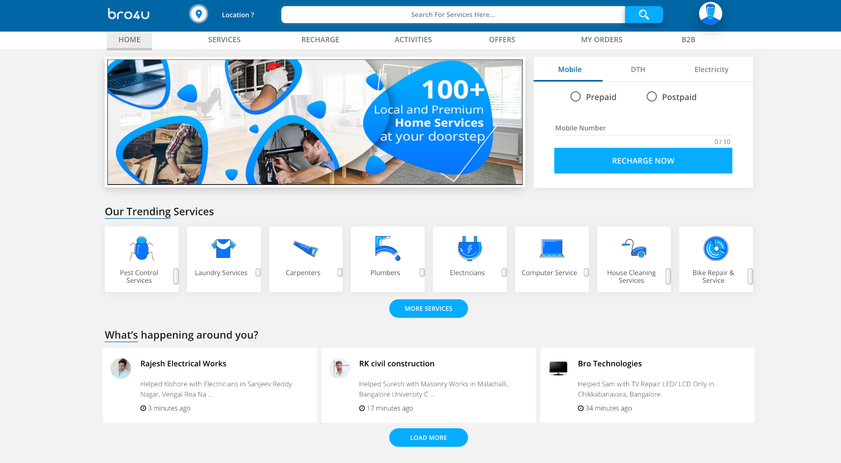
Similar Systems
bro4U
Introduction
An initiative called Bro4u aims to make people's lives easier by bringing various services right to the doorstep.
Bro4u is like a store where you can find all kinds of services. It's the one place for everything you need.

Slide 13

Pros Of Bro4u
Convenience: Users don't have to waste time looking for different vendors when using Bro4u's platform to locate and reserve a variety of services.
Broad Variety of Services Bro4u provides a wide range of services to meet various needs, from professional services to home repairs.
User-Friendly: Customers can navigate and utilize services with ease thanks to the app's user-friendly design.
Decent Pricing: When compared to other resources, users frequently find the pricing to be reasonable.

Slide 14
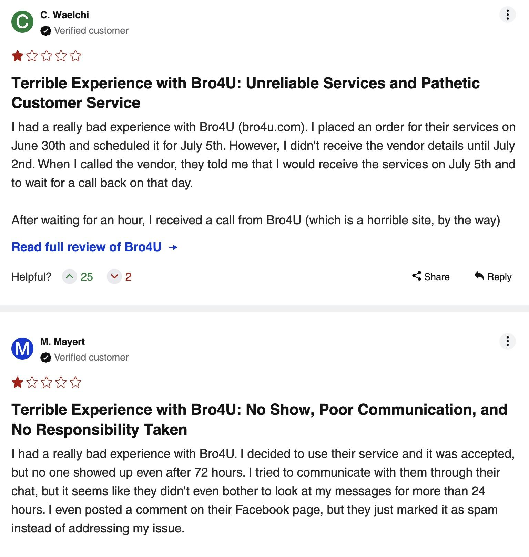
Cons of bro4u
No Travelling Charges : Users and service providers may become confused if the app does not include travel fees or if they are not clearly explained. If service providers are not adequately compensated for their travel expenses, they may be less inclined to accept assignments in remote areas.
Service Quality: Quality of service may differ depending on service provider.
Updates and Modifications: The platform may experience updates or modifications that have an impact on its features and services.

Slide 15
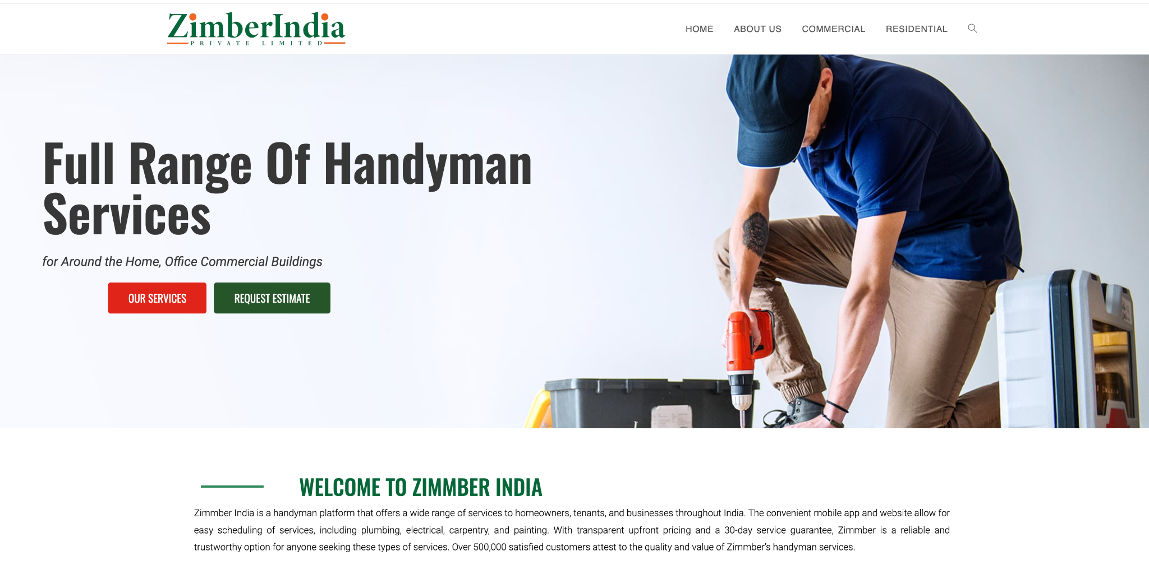
Similar Systems
ZIMMBER
Introduction
Zimmber, an Indian platform, offered different services like pest control, plumbing, electrical work, and house cleaning.
Service bookings could be made via the Zimmber website or app.
Zimmber aimed to connect you with service providers who who had their backgrounds checked and verified.

Slide 16

Pros of Zimmber
Variety of Services: To meet a range of needs, Zimmber offered a wide range of home services.
Background Verification: To establish trust, service providers on Zimmber were usually subject to background checks.
Online Booking: The Zimmber platform made it easy
for users to make reservations for services online.
Convenience: The platform's goal was to make it easier for users to access a variety of home services from a single location.

Slide 17
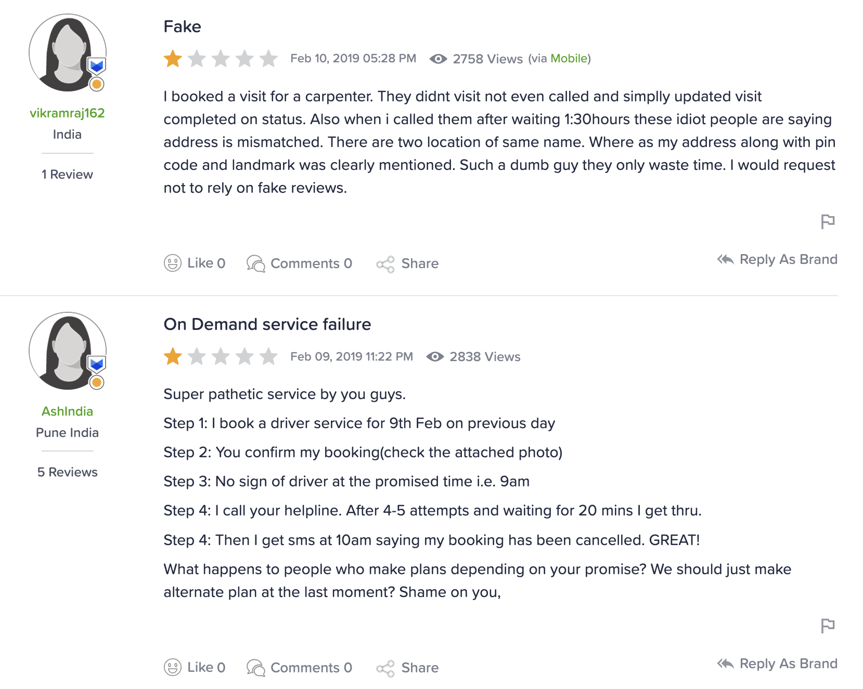
Cons of Zimmber
High Commissions: The platform will retain a commission of 40 percent from each transaction.
Limited Services: In some cities or areas services are not available.
User Reviews: Issues like poor work quality, employees not being on time, and lacking proper skills.

Slide 18

Similarities

Slide 19
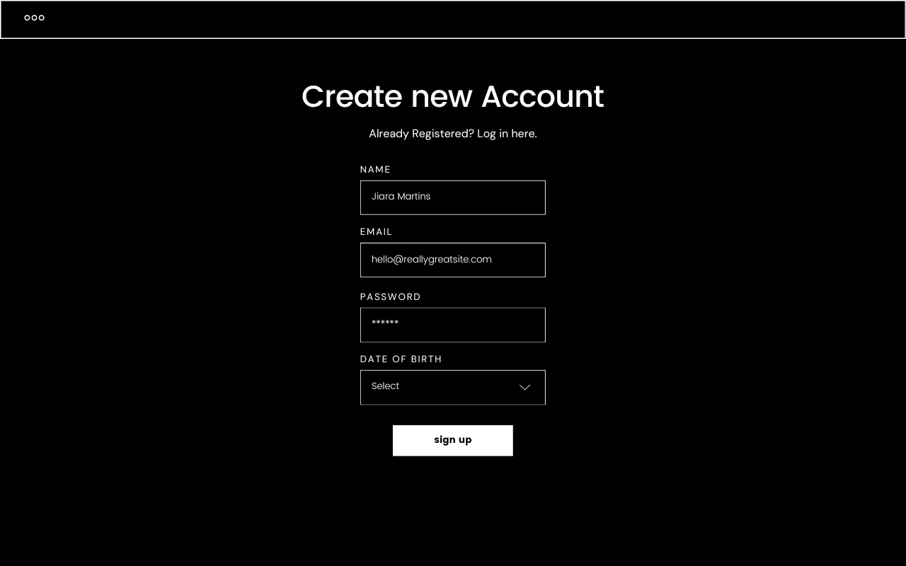
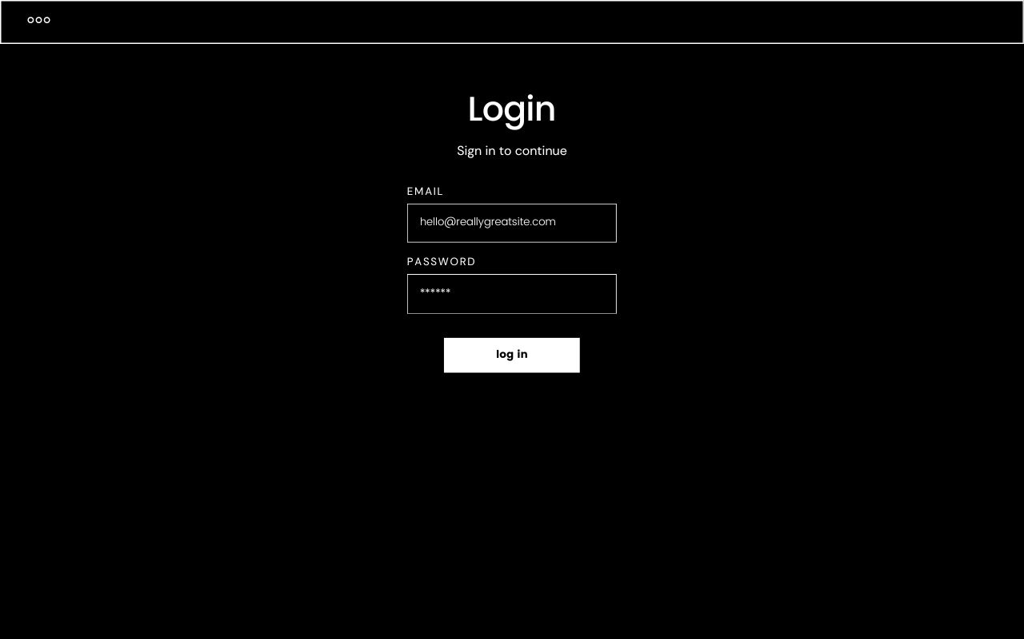
Login & Registration
Streamlined login process ensuring secure access for users.
User-friendly registration flow for a smooth onboarding experience.
Enable users to personalize profiles easily during or after registration.

Slide 20
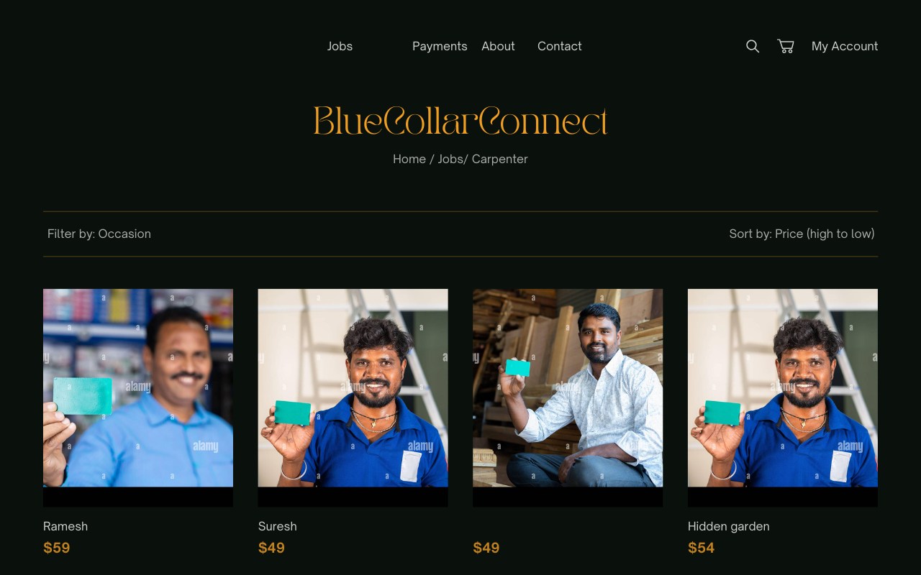
Home page with search bar
User-friendly search bar with filters for efficient employee discovery.
Employees presented in a grid format, featuring names and pricing for quick evaluation.
Sorting capabilities based on criteria like price and ratings for personalized search results.

Slide 21
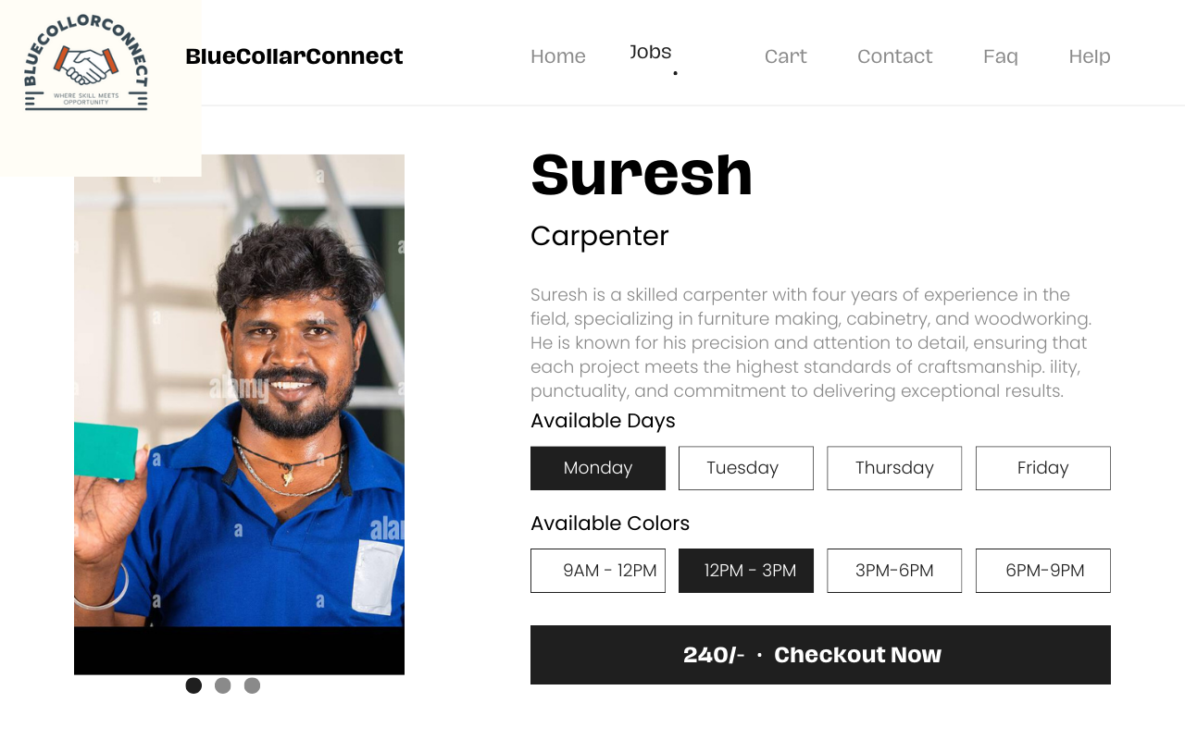
Payments
Accept payments seamlessly through UPI, debit cards, and credit cards for user convenience.
Ensure safe and secure transactions using the Stripe API, emphasizing the platform's commitment to user financial data protection.
Provide a hassle-free payment experience, allowing employers to choose their preferred payment method with ease.

Slide 22
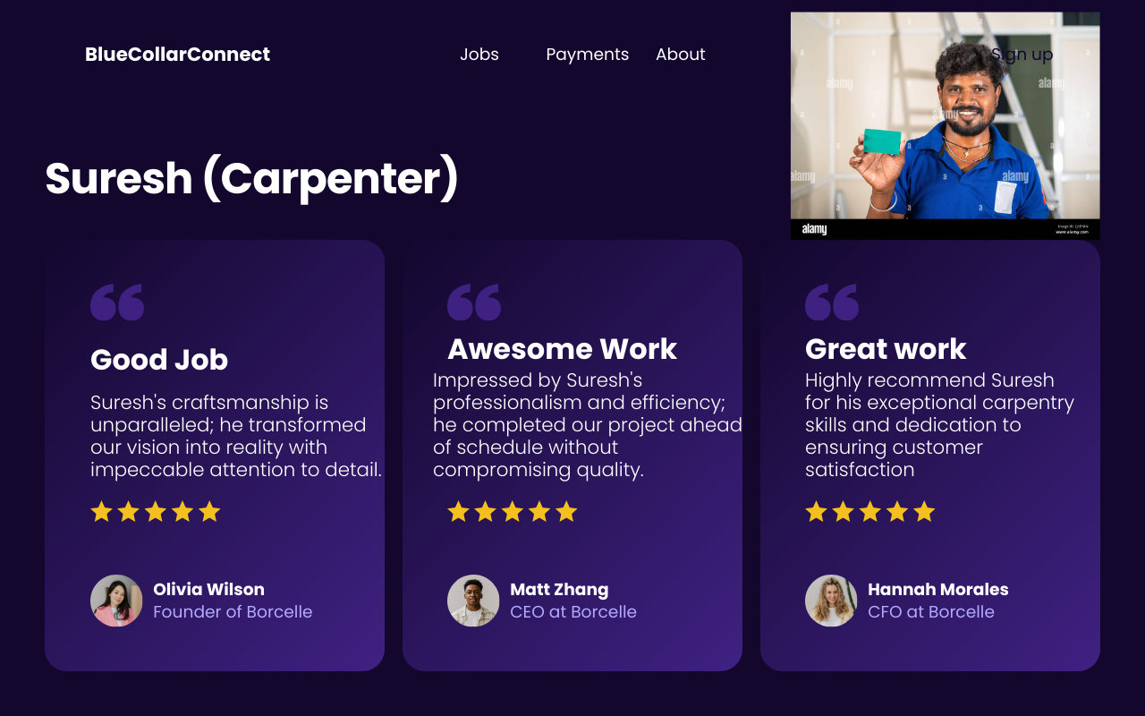
Worker Ratings and Reviews
Users can rate and review workers, influencing their pay and motivating excellent performance.
Worker profiles prominently display these reviews, aiding users in making informed hiring decisions.
Leveraging user feedback enhances transparency and empowers workers within the hiring process.

Slide 23
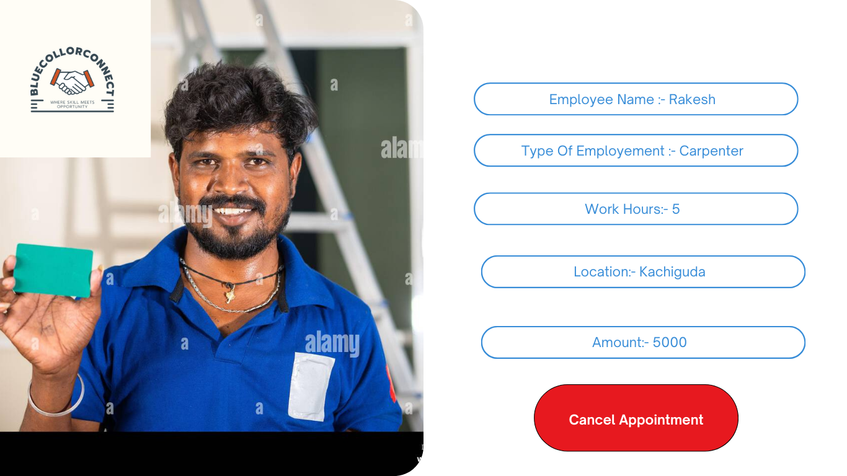
Cancellation Policy and Process
Users can rate and review workers, influencing their pay and motivating excellent performance.
Worker profiles prominently display these reviews, aiding users in making informed hiring decisions.
Leveraging user feedback enhances transparency and empowers workers within the hiring process.

Slide 24
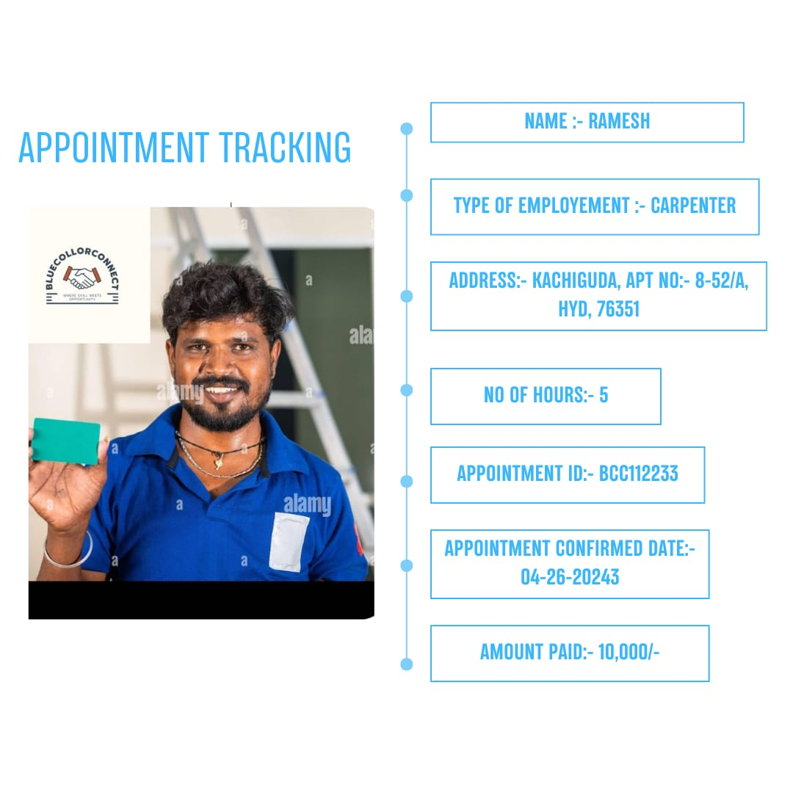
Appointment Tracking
The tracking page enables customers to monitor order status, including payment details, shipping address, order ID, and assigned worker location.
Users can seamlessly track the progress of their orders, ensuring transparency and convenience throughout the process.
The integrated order tracking system enhances user experience and facilitates effective communication between customers and workers.

Slide 25

New Features

Slide 26
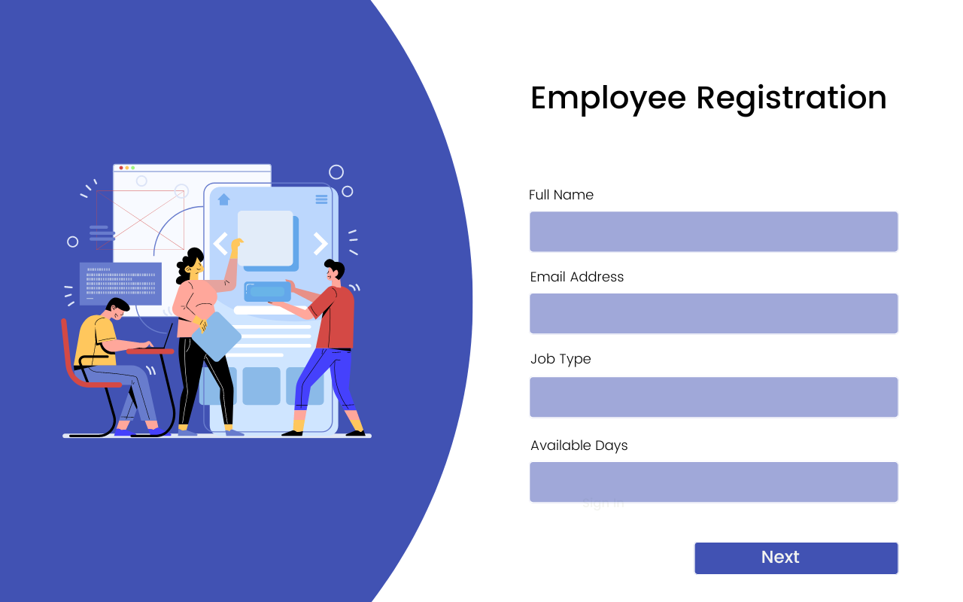
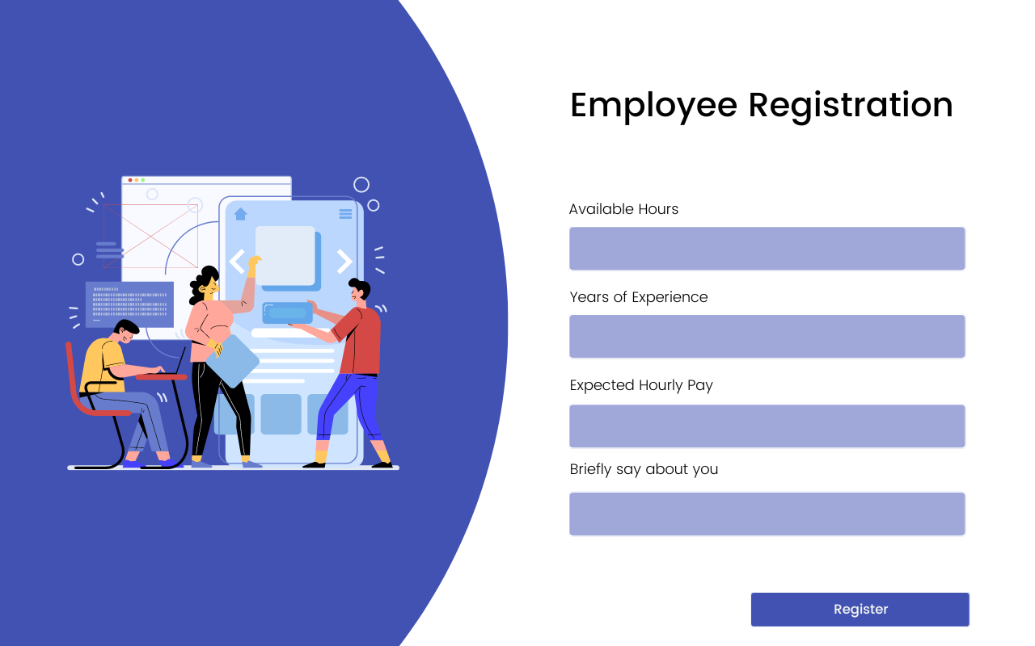
Employee Registration
Our intuitive employee registration page captures essential details including name, email, skilled job type, availability, experience, and expected hourly pay.
Hourly pay limits are set for each profession, with performance-based increases ensuring fair compensation and motivation for excellence.
Identity verification adds an extra layer of security and trust, enhancing the reliability of our platform and fostering a positive user experience.

Slide 27
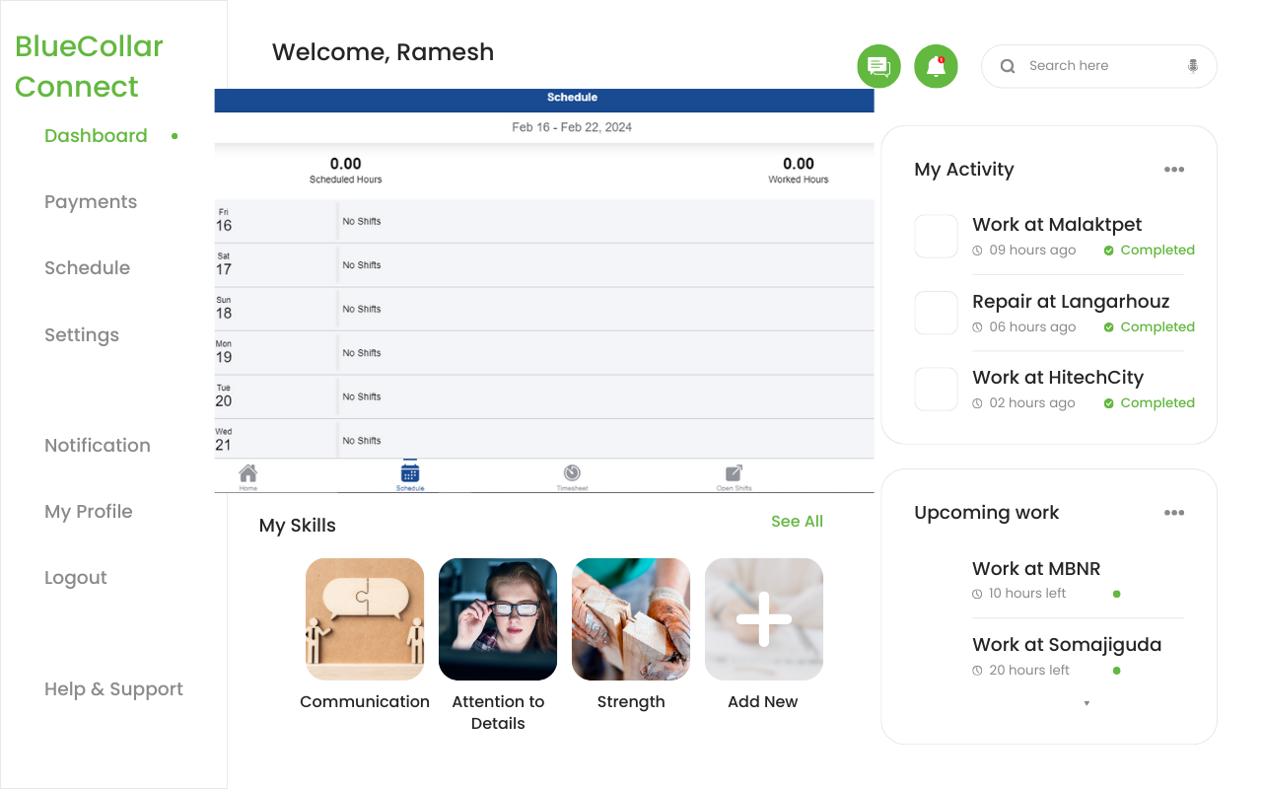
Employee Dashboard
The comprehensive worker dashboard features a weekly schedule, past activity logs, and upcoming assignments, ensuring efficient time management and clear task prioritization.
Payment details from previous employments are readily accessible, providing transparency and facilitating financial planning for workers.
Workers can conveniently edit their skills directly from the dashboard, ensuring their profiles remain up-to-date and accurately reflect their abilities and expertise.

Slide 28
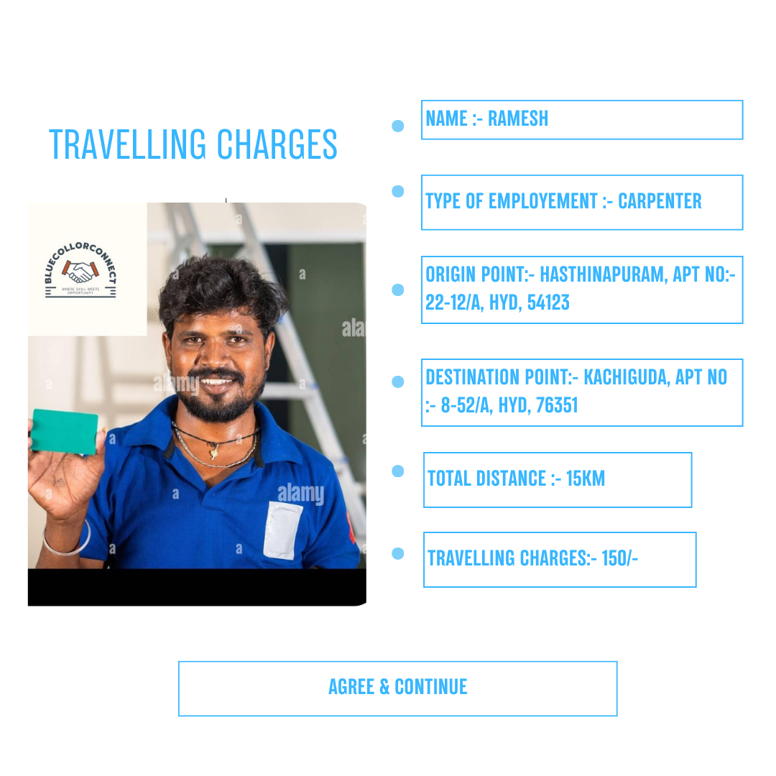
Travel Charges
Our new feature introduces transparent travel charges for worker commutes, calculated based on city zones and distance traveled per kilometer.
Customers are informed of applicable travel fees during booking, ensuring clarity and fairness in service pricing.
Travel charges contribute to worker compensation and efficient service delivery, enhancing overall customer satisfaction and worker motivation.

Slide 29

Shift Exchange
Our platform facilitates seamless shift exchanges between users, maintaining continuity while accommodating individual scheduling needs.
Users can efficiently manage their shifts by swapping with others of the same rating and price, ensuring operational stability and user satisfaction
This feature promotes flexibility and collaboration, enhancing workforce efficiency without necessitating full employee replacements.

Slide 30

Employee Recognition System
Our monthly employee recognition system elevates top performers in each profession based on ratings and reviews, fostering a culture of excellence and motivation.
In the search view grid, badges such as "Best Performer" highlight exceptional employees, providing users with valuable insights and facilitating informed hiring decisions.
This feature promotes flexibility and collaboration, enhancing workforce efficiency without necessitating full employee replacements.

Slide 31

Customer Acquisition

Slide 32

Innovative Features for Customer Attraction
Transparent Travel Charges: Customers are informed of travel fees based on city zones and distance traveled per kilometer, ensuring clarity and fairness in pricing.
Shift Swap Capabilities: Our platform enables seamless exchange of shifts between users, maintaining operational stability and accommodating individual scheduling needs.
Monthly Employee Recognition: Top performers are elevated based on ratings and reviews each month, fostering a culture of excellence and motivation among employees and attracting customers seeking quality service.

Slide 33

Streamlined User Experience
Intuitive Interface: Our user-friendly website design and comprehensive search functionality simplify the hiring process for customers, ensuring they find quality employees efficiently.
Extensive Employee Network: With a vast pool of skilled professionals accessible through our platform, customers have access to a wide range of talent in various fields.
Review-Based Hiring System: Customers can make informed decisions by leveraging our review-based hiring system, ensuring they select reliable and trustworthy workers for their needs.

Slide 34

Employee-Centric Approach
Free Employee Registration: Workers can register on our platform without any registration fees, making job opportunities accessible to all without financial barriers.
Commission-Free Model: Employees receive full payment for their work without any commission deductions, fostering trust and loyalty among workers and attracting top talent to our platf
Competitive Environment: Our platform encourages healthy competition among employees for top reviews and ratings, ensuring quality service delivery and building long-term relationships with customers.

Slide 35
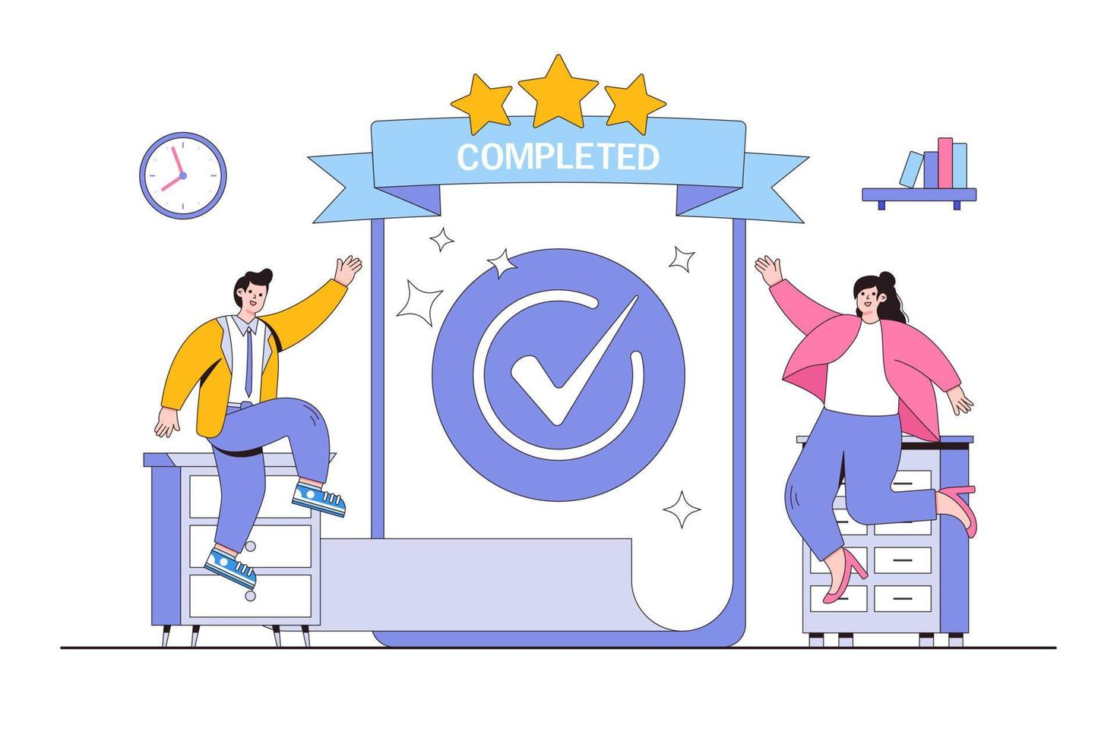

Promoting Repeat Business and Reliable Service Offering
Contact Exchange Feature: Customers and workers can exchange contact information after completing a job, promoting ongoing relationships and future bookings.
Reliable Work Completion: Our swap feature guarantees work completion, even in unforeseen circumstances, ensuring reliability and peace of mind for customers.
High Customer Satisfaction: Our commitment to service excellence and employee welfare leads to high levels of customer satisfaction and loyalty, promoting repeat business and positive word-of-mouth referrals.

Slide 36
System Interface Overview

Slide 37
TEAM RESPONSIBILITIES
Iteration One (Completed) | Going forward (Projected)
Gowtham (Team Leader) : Took the lead in brainstorming ideas, refining existing features, and envisioning new ones to draw users to the platform. He also focused on designing the website interface to ensure it appeals to users and meets industry standards. | Sneha (Team Leader) :Will take lead the development efforts, focusing on learning Django technology. She will be responsible for implementing the login and registration pages, as well as the cancellation feature.
Sneha :conducted thorough research on similar systems, analyzing their functions and exploring the required technologies for our project. Her insights guided our development approach, helping us make informed decisions as we moved forward with the project | Gowtham :Will learn Django technology to enhance his development skills. He will focus on designing the homepage with a search bar and implementing the payments page

Slide 38

THANK YOU

